Slide 1

Case study: Student Adaptivity Level to Online Classes
Azure ML Prediction: Low/ Moderate/ High
Stegarescu Ana-Maria, grupa 407

Slide 2
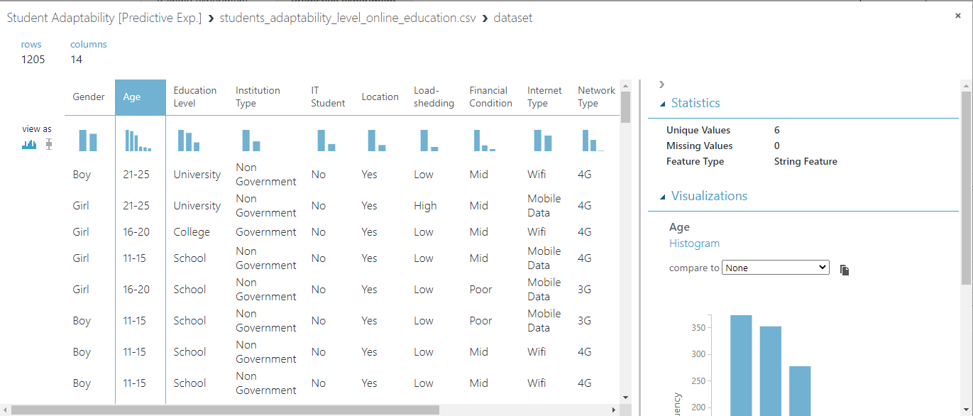
Visualizing the Dataset:
Source: www.kaggle.com

Slide 3
Types of values contained by each column:
Gender | Age | Education Level | Institution Type | Location * | Load-shedding | Financial Condition | Internet Type | Network Type | Self LMS | Class Duration ** | Device
Boy | 6-10 | School | Government | Yes | Low | Poor | Mobile Data | 4G | No | 0 | Mobile
Girl | 11-15 | University | Non Government | No | High | Mid | Wifi | 3G | Yes | 1-3 | Tab
 | 16-20 | College |  |  |  | Rich |  | 2G |  | 3-6 | Computer
 | 21-25
 | 26-30
*If the student lives in the same location with the institution they attend
**Class duration in hours

Slide 4
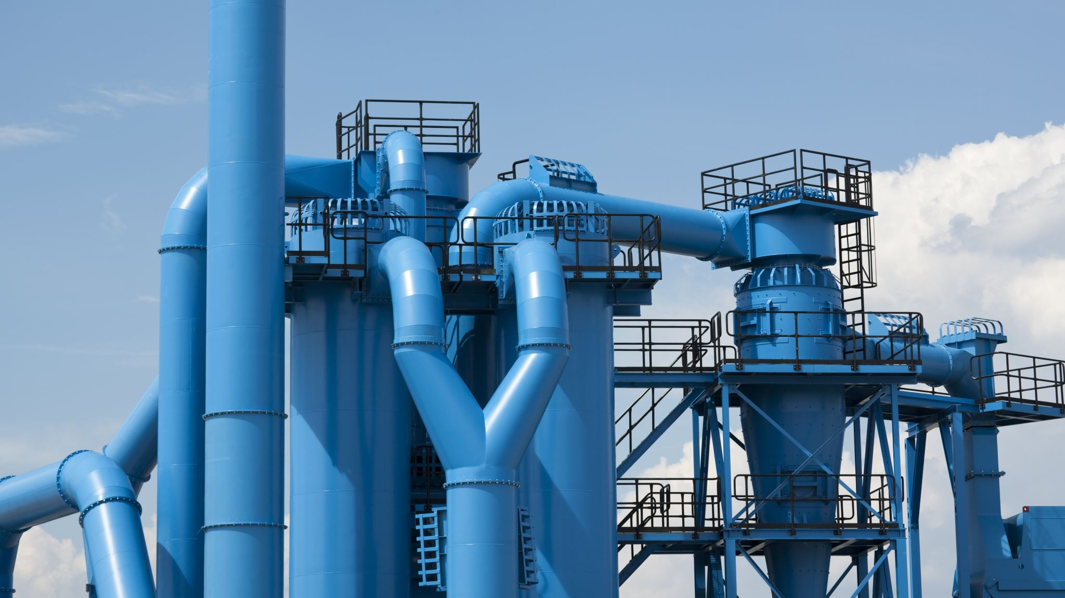
Azure Pipeline Workflow

Slide 5
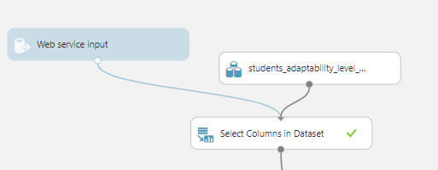
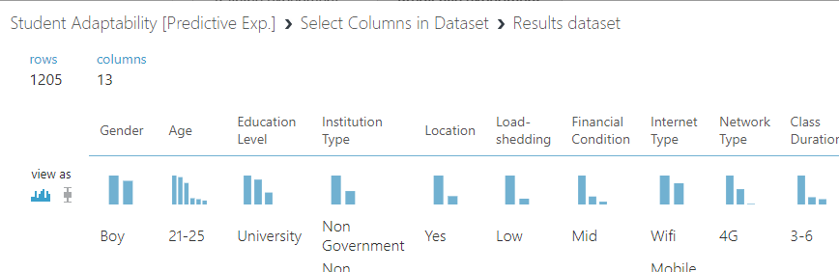
Data preprocessing: Eliminating the “IT Student” column
Obtained dataset of 13 columns (out of 14):

Slide 6
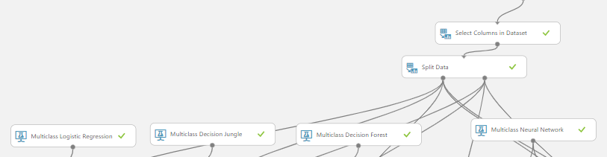
Splitting the data and picking the models:
The data has 1205 rows total. I split it by a 0.8 ratio (80% for train and 20% for test).
I tested all multiclass prediction models Azure ML had to offer in order to deploy the model with the best results.

Slide 7

Testing the problem on different models

Slide 8
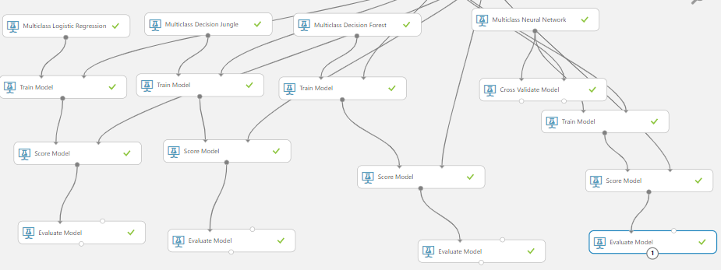

Slide 9

Evaluating the models

Slide 10
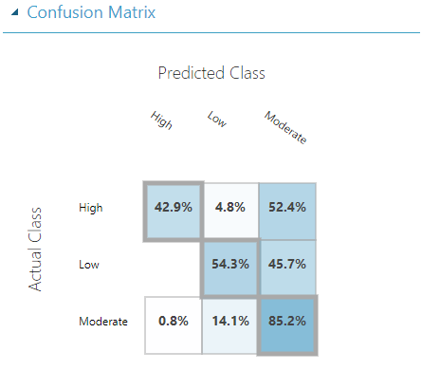
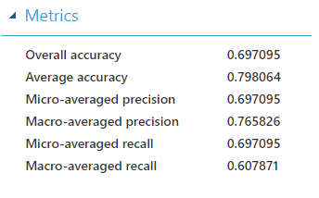
Multiclass Logistic Regression Results:

Slide 11
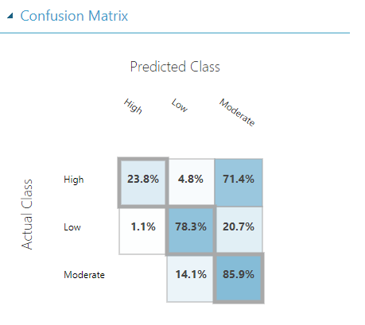
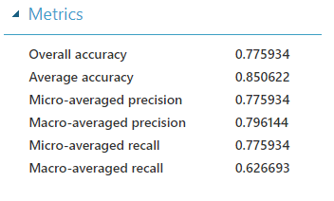
Multiclass Decision Jungle Results:

Slide 12
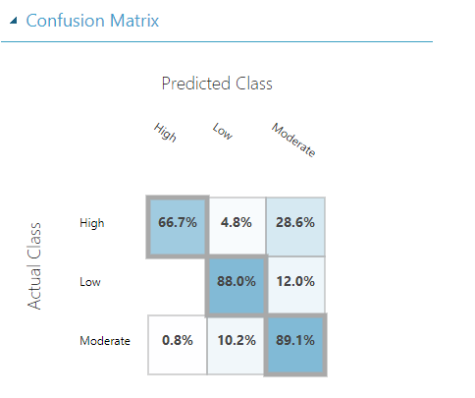
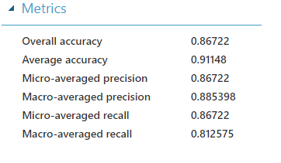
Multiclass Decision Forest Results:

Slide 13
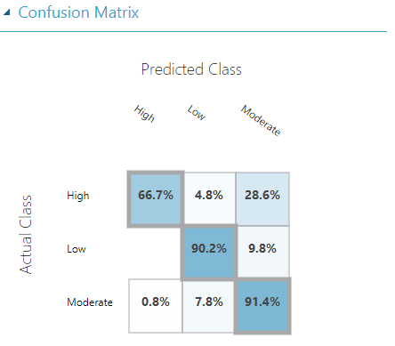
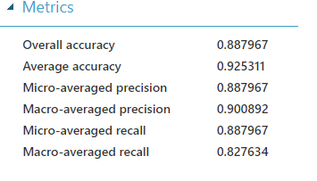
Multiclass Neural Network Results:
*Best results compared to other models

Slide 14
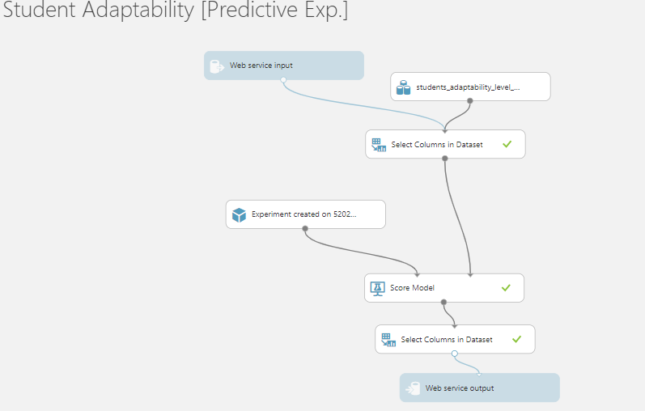
Model deployment: Setting up the web service

Slide 15
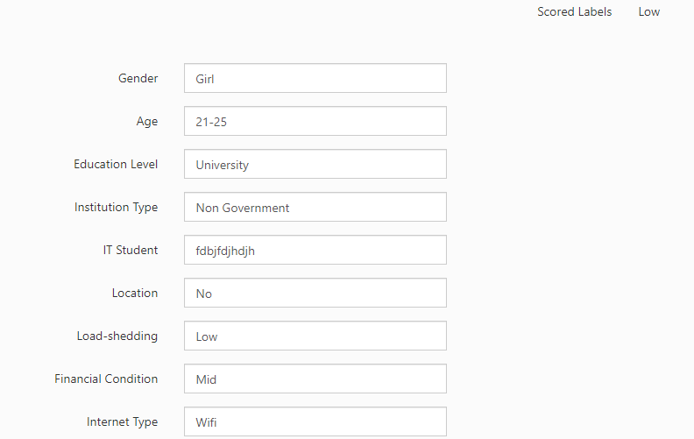
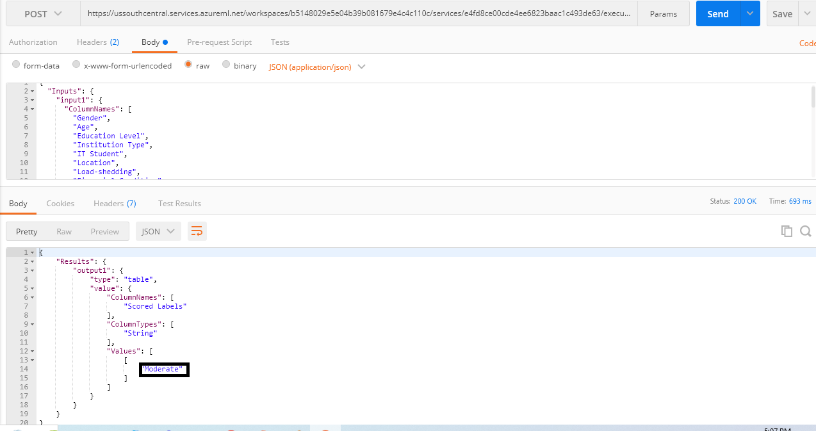
Deployment: Testing in AzureML vs Testing with Postman

